Slide 1
<h1>Html5 the basics</h1>
Mwayi Mchuchu (Adjunct Staff Associate)

Slide 2
Introducing Html
Hypertex Markup Language 5 (HTML)
A markup language combines text as well as coded instructions on how to format that text and the term "markup" originates from the traditional practice of 'marking up' the margins of a paper manuscript with printer's instructions.
Nowadays, if you mention the term 'markup' to any knowledgeable web author, the first thing they are likely to think of is 'HTML’.
History
product of SGML (Standard Generalized Markup Language) which is a complex, technical specification describing markup languages, especially those used in electronic document exchange, document management, and document publishing.
official language of the World Wide Web and was first conceived in 1990.
Developed to foster science publications for those who couldn’t use SGML, HTML had added feature of linking documents electronically using hyperlinks. Thus the name Hypertext Markup Language.
With the evolution of the World Wide Web, HTML began to proliferate and quickly spilled over into the mainstream, as it was discovered to be self contained and easy to learn.
Several versions in between Most Current acceptable HTML Standard (HTML5).

Slide 3
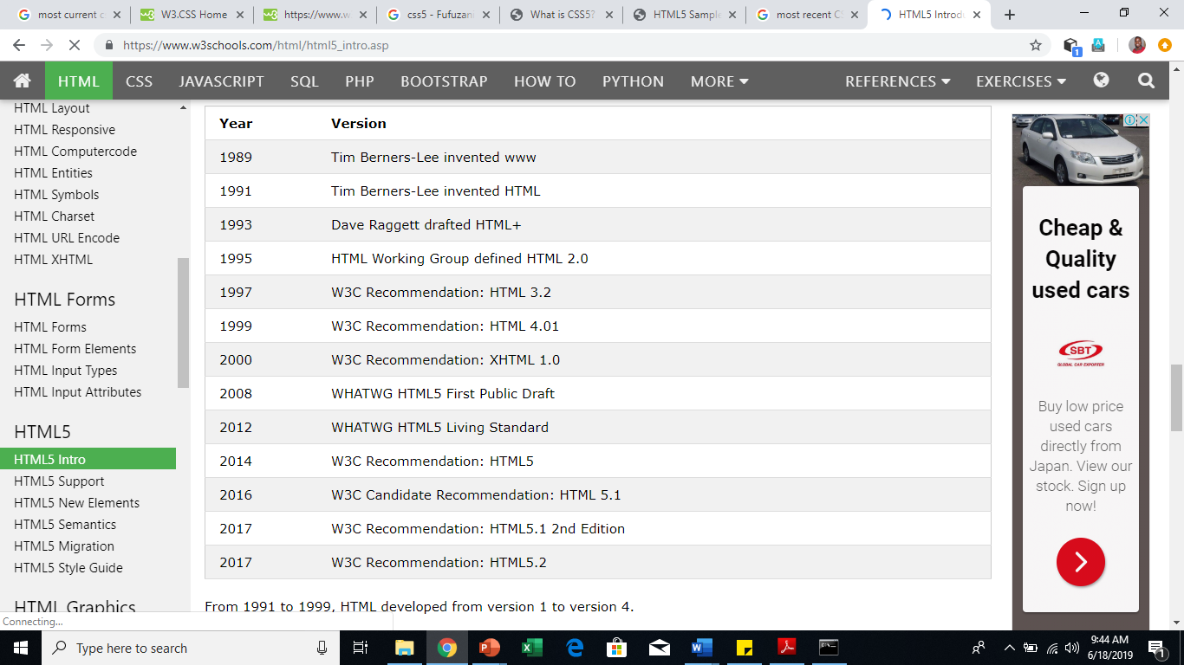
Html development timeline

Slide 4
Html 5 technologies
The term HTML5 encompasses a broad spectrum of technologies that together provide a compelling platform for building great web applications. These can be organized into three areas:
1) HTML 5– the web content, including markup instructions. (Framing)
HTML5 introduces more descriptive HTML tag elements. These include header, footer, nav, video, article, section and others.
2) CSS – the styling rules that define how the content is presented. (presentability, beauty, conceivable)
3) JavaScript – provides client-side scripting and advanced capabilities. (interactivity)
This presentation introduces the basics of html(5)

Slide 5
HTML 5
a markup language is used to call out parts of the document and provide instructions or background information.
Instructs the browser how to render (extract and display) information
HTML5 is a relatively mature standard, or more accurately, a set of standards that is managed by the World Wide Web Consortium (W3C). For example, the overall HTML syntax is defined in https://www.w3.org/TR/html5/syntax.html.
Web browsers receive HTML documents from a web server (URL the hosting machine) or from local storage and render the documents into multimedia web pages.
A basic webpage is built with html tags, elements as the building blocks and content nested in the html tag elements.
Html pages can also be known as html document

Slide 6
Html 5 (tags and elements)
HTML page or documents are made up of tags and elements that are nested in a hierarchical fashion
Tag
HTML tag. HTML tag. An HTML code that defines every structure on an HTML page, including the placement of text and images and hypertext links.HTML tags begin with the less-than (<) character and end with greater-than (>). These symbols are also called "angle brackets.
Tags have an opening tag and a closing tag differentiated by a forward slash in the closing tag. Eg <></>. The first is an opening tag the second beginning with a / is a closing tag.
Element
An HTML element is an individual component of an HTML (Hypertext Markup Language) document or web page. HTML is composed of a tree of HTML nodes (character based semantic representation), such as text nodes. Each node can have HTML attributes specified. Nodes can also have content, including other nodes and text.
The basic elements of an HTML page are: A text header, denoted using the <h1></h1> biggest to <h5></h5> smallest, elements are nested in tags with a corresponding start and ending tag.
How ever there other distinct elements that do not follow the logical opening or closing there denoted with just one opening tag. These are called empty tag eg <br> representing break line, (jump one line below).
The term tag and elements are used interchangeably and often confused but its more less the same thing.

Slide 7
Html elements continued
There is a growing number of HTML elements I cant list them all in this presentation. Below are the main points to note.
HTML elements are easy to remember as they represent the everyday text based language of the document structure. Below are some of the examples.
<p> for paragraph
<ul> For unordered list
<div> for dividing a section
<head> for degining webpage’s head, <body> likewise, <footer> for page footer
<video> for adding video
<href> denoting hyperlink reference
What is cool with HTML 5 is that you can define your own elements, or mix as long as you know what your doing. But following the basic standard is advisable for future developments. What if the website is to be further developed by someone, it should be easy to follow. That’s why we have standards.

Slide 8
Types of Html elements (block level)
The building block elements of each html page
Two main types of HTML elements "block-level" elements or "inline" elements.
By default, a block-level element occupies the entire space of its parent element (container), thereby creating a "block.“
Block elements usually starts on a new line. Examples are;
<address> <article> <aside> <blockquote> <canvas> <dd> <div> <dl> <dt> <fieldset> <figcaption> <figure> <footer> <form> <h1>-<h6> <header> <hr> <li> <main> <nav> <noscript> <ol> <p> <pre> <section> <table> <tfoot> <ul> <video> etc
Block level elements can contain inline elements and other block level elements nested within
Every HTML element has a default display value depending on what type of element it is. The default display value for most elements is block or inline.

Slide 9
Types of Html elements (inline)
Inline elements are those which only occupy the space bounded by the tags defining the element, instead of breaking the flow of the content.
Are contained within a block level element
Do not start a new line
<a> <abbr> <acronym> <b>
<bdo> <big> <br> <button>
<cite> <code> <dfn> <em> <i> <img>

Slide 10
Html attributes
All HTML elements can have attributes
Attributes provide additional information about an element
Attributes are always specified in the start tag
Attributes usually come in name/value pairs like: name="value"
For example to add an image on the website you will need the <img> element then the src attribute. Which defines a url to the image source. The attri
As stated above the image element and its attribute would be <img src="/images/logo.gif">
Attributes are always presented by the equals sing set of double quotes (="")

Slide 11
Html attribues continued
Most common attributes in HTML are the class and ID attributes
The class attribute mostly used in applying styling, where styling presentation is declared to a given class name (it can be any name) and all elements given the class attribute of the defined value will be formatted with the declared styles of that class.
ID can also be used for styling and also navigation, one ID value can only applied to only one element.
One common Attribute is in web programing is the type attribute. For example <button type=“submit“ value=“submit"></button>
There is a set of attributes called global attributes that can be used on any HTML element. A complete list of these can be found at https://html.com/global/
The most common ones that you’ll use are id and class. The id attribute defines a unique key for an element; it must be unique within the entire HTML document.
This is often used when accessing an element in JavaScript
The class attribute is sometimes called the CSS class, because it is often used for applying styles to an element. Unlike id,
the class attribute is a non-unique key; a single value is applied to elements that need to have identical formatting.

Slide 12
Html page
Each HTML page has the defining block elements starts with the html and ends with the html tag element. <html><head>,<title></title></head><body></body></html>
HTML elements should be orderly nested to work. Inline elements close first before closing the block level
HTML Page Document must be saved with a .html file extension to be recognized by browsers as a document with HTML instructions
Simple HTML5 Document would be as below
<!DOCTYPE html>
<html lang="en">
<head>
<meta charset="utf-8" />
<title>HTML5 Sample Document</title>
</head>
<body>WELCOME TO WEB MULTIMEDIA</body>
</html>

Slide 13
Html page i
Important to remember that all html pages must be saved with a .html extension.
You might have noted in the previous simple html page slide DOCTYPE.
The DOCTYPE element is an oddity (habit) and doesn’t fit any of the standard element formats.
It just signals to mention the version, was common in the previous version of HTML(XHTML).
Was useful then to tell browser the html type to be rendered (extracted and displayed)
HTML five how ever just goes with <!DOCTYPE html> without specifying the version.
Since the doc type has no actual value to the html syntax, if left out any just type <html> there will be no differencew. But since it has become a norm then its optional.

Slide 14
Html page ii
The meta element is an abbreviation for metadata, which is data that describes other data. In this case, the meta element describes the contents of the HTML document. The head element can include any number of
meta elements, each providing a single data point using the name/value pair construct. For example: <meta name="author" content="Mark J Collins" /> <meta name="description" content="Sample HTML document" />
Meta element includes a charset attribute:
<meta charset="utf-8" />
The charset attribute specifies the type of character-set encoding that this page uses. You should always define the character set; however, this is particularly important if your page needs to display nonstandard characters.
There are some Boolean attributes that do not need a value; their existence indicates a true value and their absence means false.
For example, a check box has a checked attribute if checked and this attribute is removed if not checked.

Slide 15
Html page iii
The head element just denotes the page’s section that this section will hold the elements to be displayed on top. It usually nests the title and nav elements
Title Element
The title element specifies the title of this page. This shows up in a couple of places:
In the browser title bar or tab
Search engines will usually include this in the search results
When adding a page to your favorites or bookmark, the title is used as the name
Html Element
So, as you’ve already seen, the html element is the root node: the starting and ending point of your document.
The html element can contain one head element and one body element. In addition to the global attributes, it also supports the manifest attribute.

Slide 16
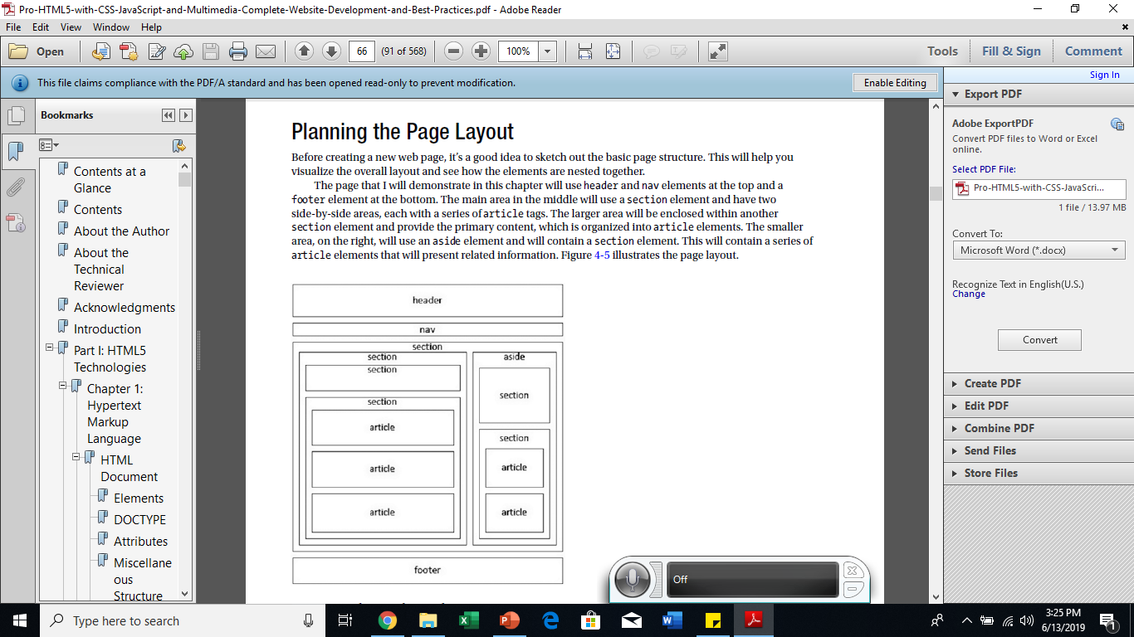
Designing website based on html5 elements
Image depicts the elements of html and how what they represent based on the element /tag description.

Slide 17
Nesting html tag / elements
Nesting Tags. HTML tags should be “nested” in a proper order, meaning that the tag opened most recently is always the next tag to close. In the following example, theHTML code is nested correctly, and we've drawn lines to connect opening and closing tags:
The below samples show how nesting can be done using a paragraph tag/element
Notice that the meta element does not have a closing tag. There are a few elements that do not have to use a closing tag, which are referred to as self-closing tags.
It may be somewhat obvious, but these elements cannot have any content since the content is placed between the opening and closing tags. The “/” character at
the end of the tag is technically optional, but the general consensus is that it should be included and some. For example the img tag <img src=“chithunzi.jpg”/>
HTML validators will flag this as a warning if it’s not there

Slide 18
Lets get our hands dirty
HTML Comments
A guide that helps developers remember certain aspects of the html page for future updates.
HTML code sections can have comments on what purpose is being served by that section
It can also help another developer easily maintain the page
Note you can type html comments using the below common html comment tags
<!-- comment content -->
It is how ever important to decide when to comment,
Its important to comment only important sections
Too many comments may just add a lot of junk to be read by a developer when trying to maintain the page
Now that we have the basics why don’t we start learning through practice?
30 minutes practice session
Practice makes permanent ensure your practicing the recommended standard.

Slide 19
global ELEMENTS
The below HTML page has several meta, link and style elements explained in the next slide
<!DOCTYPE html>
<html lang="en" manifest="sample.appcache">
<head> <meta charset="utf-8" /> <meta name="author" content="Mark J Collins" /> <meta name="description" content="Sample HTML document" /> <title>HTML5 Sample</title>
<link rel="icon" type="image/x-icon" href="HTMLBadge.ico" />
<link rel="alternate" type="application/pdf" href="MainPage.pdf" />
<link rel="author" href="mailto:markc@thecreativepeople.com" />
<link rel="author" type="text/html" href="http://www.thecreativepeople.com" />
<style media="print">html { color: black;} </style>
</head><body><h1> MULTIMEDIA CLASS 2019!</h1></body></html>

Slide 20
more html page global elements
We already looked at the metadata element
The link element is used to reference additional external resources, which can be grouped into two categories. In general defines a link between html document and external
First, links are used to load resources that are used to render the source document – the most common of these being cascading style sheets. <link rel="stylesheet" type="text/css" href="Sample.css" />
The second category is links to other related documents. Eg <link rel="icon" type="image/x-icon" href="HTMLBadge.ico" />
The style element is used to define internal CSS. To be further clarified during CSS
Script Element
The script element is used to load JavaScript in your page. In order to use a function, you must either define it or load an external script file that contains the function. Either can be done in the script element.
To define JavaScript directly, include it in between the opening and closing tags like this:
<script type="text/javascript"> function doSomething() {alert("Hello World!");} </script>
Normally, as the browser is parsing an HTML document, when a script element is encountered, the script is loaded and executed before continuing to parse the rest of the document.

Slide 21
Mastering html5
Mastering HTML 5 is easy if you know what your doing and are practicing the right way.
To access a full list of all html5 tags with explanation plus examples visit the link below:
https://www.bitdegree.org/learn/html5-tags
You can also visit
https://www.w3schools.com/html/html5_semantic_elements.asp
There more resources depending on ones preference. The below link only provides description of each of the HTML5 element but without examples.
https://developer.mozilla.org/en-US/docs/Web/HTML/Element

Slide 22
references
Mark J Collins, Apress 2017. Pro HTML5 with CSS, JavaScript, and Multimedia: Complete Website Development and Best Practices, Apress Media, LLC

Slide 23
End of presentation
Any questions?

